Slide 1




Final Project
Anna Day
John Arney
Eva Hawkins

Slide 2
Prediction of Normal Butane Vol%

Slide 3



Technologies Utilized
GitHub
Python
Jupyter Notebook
SK Learn Machine Learning
Excel CSV
PostgreSQL
Pgadmin
Quick Data Base Diagram
Flask
Psycopg2
Gunicorn
Heroku
VS Code
HTML
JavaScript
CSS
Google Slides

Slide 4
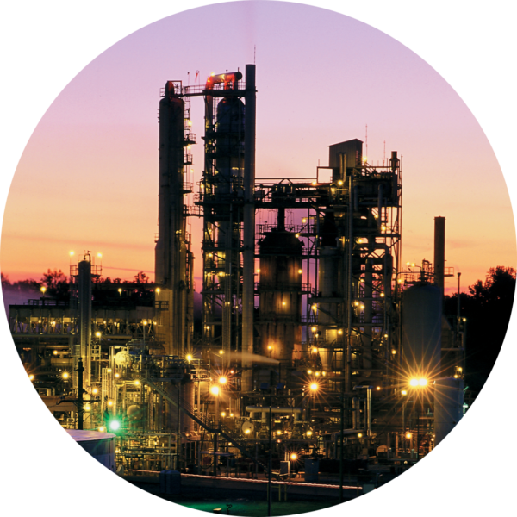
T0pic
Prediction of Normal Butane Recycle to Reactor
Utilize plant data from multiple unit assets to develop machine learning methods to predict "live" volume percentage of N-Butane build up in Tower A recycle line to Reactor.
Reason for Choosing Topic
Real World Topic
Availability of Unique Datasets
Shows Machine Learning Potential
$1.2M Annual Cost Benefits

Slide 5
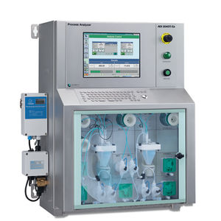
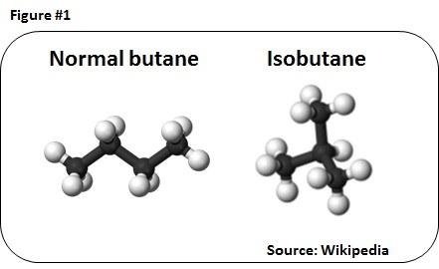
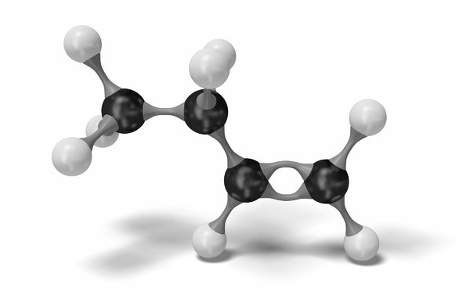
Background
Challenges:
Lab sample frequency periods
Online Analyzer is expensive and corrodes due to acidic reaction catalyst
Subtle N-Butane accumulation is difficult for humans to recognize effectively
In gasoline refining, Butylene and Isobutane combine to create Alkylate, a major blend component in gasoline.
Because normal butane is inert in the reaction, excess normal butane accumulates in the recycle stream, resulting in unfavorable reaction conditions.
Normal Butane
Iso-Butane
Butylene
Desired Reaction
Inert

Slide 6
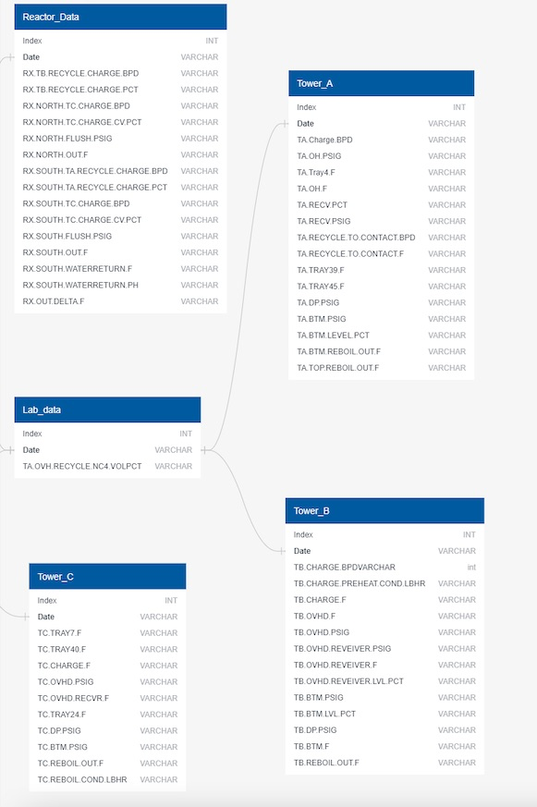
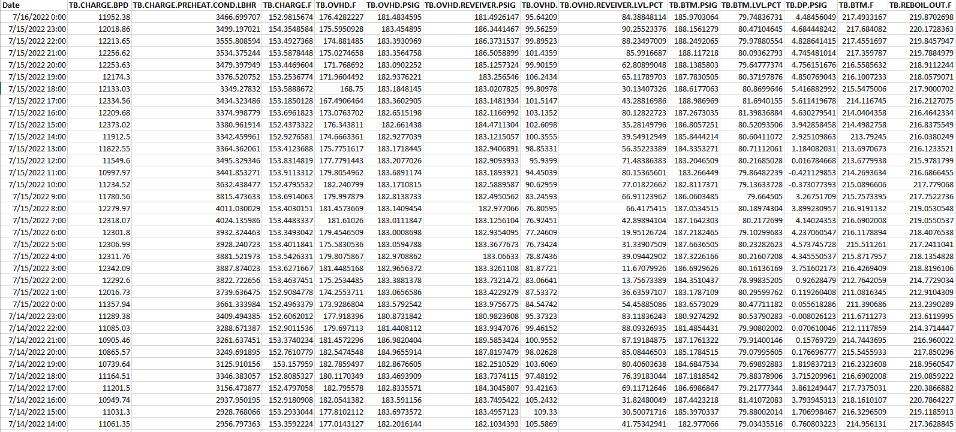
Data Source
Used real refinery historian and lab data
Twice Daily Lab Sample from 7/16/2022 – 1/1/2021

Slide 7
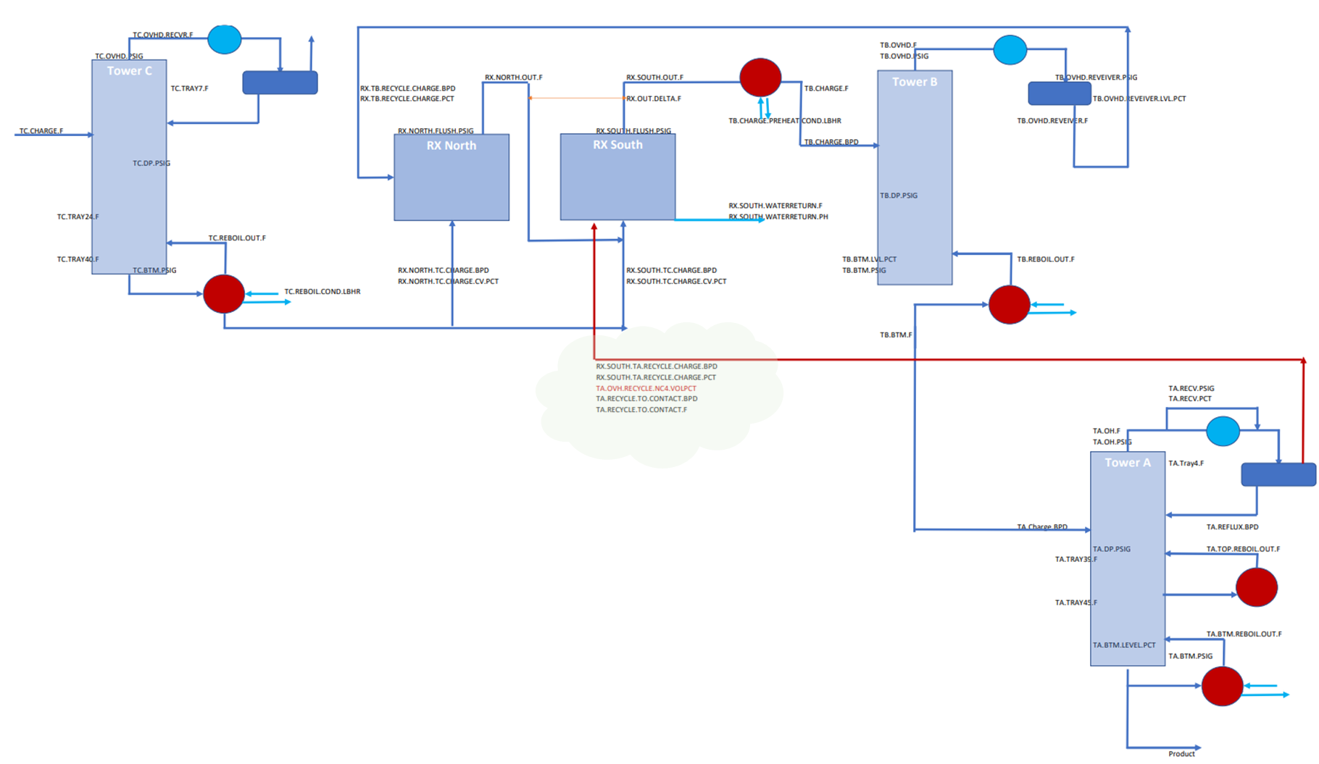
Process Block Flow

Slide 8
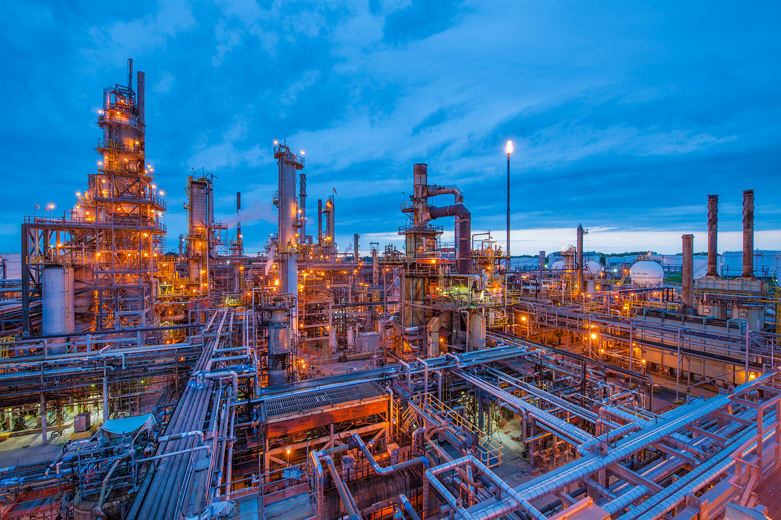
Desired Outcome
By allowing Realtime monitoring and thus, optimization of N-Butane levels, the following opportunity cost benefits may be realized annually:
Online Analyzer Replacement Costs: $1M
Octane Optimization: $700K
Maintenance Costs: $500K
Total = $1.2M annually
The project analysis output hopes to provide plant operations with a live view of the predicted Volume Percentage of N-Butane in the Tower A Recycle line.
Aiming for Mean Error of 2 volume percentage points

Slide 9
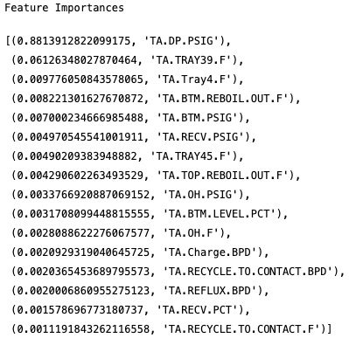
Data Exploration
Feature Importance
Feature coefficients, and correlations to understand the relationships of the features among each other and with different model types.
The feature importance functions such as model.coef_ and model.feature_importances_ allowed for a systematic ranking of features.
The exploratory data analysis process began with checking the raw data for non-numerical values.
Remove String: "Bad", "Bad Input", "Error", and "I/O Timeout".
Remove Outliers: Generated summary statistics to get an idea of the spread of the data values.
Remove Shutdown Data: Turnaround for the plant, meaning that the plant itself was shut down and all the data collected in the period was invalid.

Slide 10
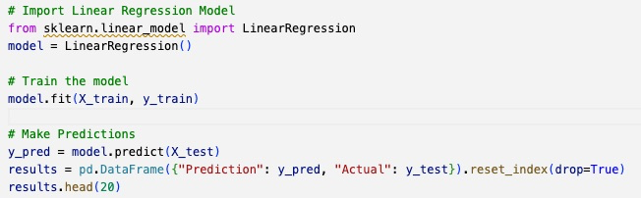
Analysis Phase
SK Learn's Linear Regression model was selected
This model was chosen because the output (y_predict) was more accurate, and an actual representation of the N-Butane Vol%, rather than a binary grouping prediction is output.
This number based prediction proves more valuable in real-world operations of the process unit in question.
Twelve (12) provisional machine learning models were created
- Tower A: (Linear Regression, Logistic Regression, Random Forrest, and Support Vector Machine)
- Tower B: (Linear Regression, Logistic Regression, Random Forrest, and Support Vector Machine)
- Reactor: (Linear Regression, Logistic Regression, Random Forrest, and Support Vector Machine)

Slide 11
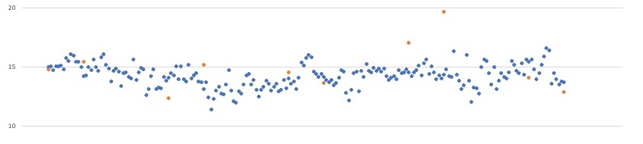
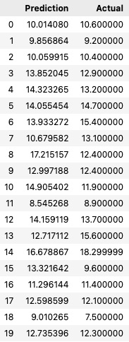
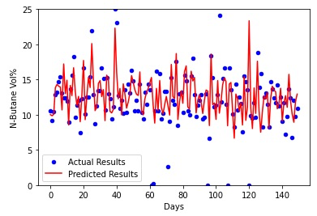
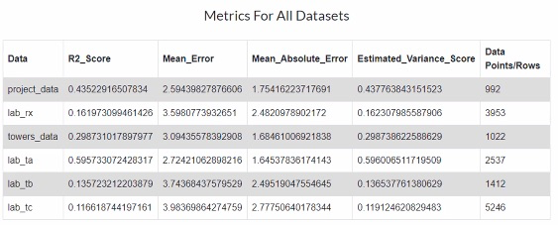
Results
“Real Time” Data Input
New dataset was taken from the past 3 weeks and ran in model to simulate an operators view of actual and simulated N-Butane Vol%
Performance Metrics
The model testing performance, when used to predict the X_test split, was quite robust though not perfect

Slide 12
Recommendation
Dashboard
In conclusion, there is certainly limitations to the model.
While it does not predict the N-Butane Vol% exactly, it does seem to trend the general direction of the N-Butane Vol%, and generally predicts this figure within 2-5 Vol% points.
Reexamine ETL Process (reduce mergeable data loss)
Future Models (choose neural network regression model)
Operational Background (work with operations to determine normal operation conditions)
Feature Importance and Correlation (further optimize model inputs)
Presentation

Slide 13
Questions?

